Slide 1

Digital Portfolio
STUDENT NAME : SARAVANA VELAN M
REGISTER NO AND NMID : 9842BC47D8CA961801D4374A9230427A
DEPARTMENT : BCA
COLLEGE :GOVERNMENT ARTS AND SCIENCE
UNIVERSITY : UNIVERSITY OF MADRAS

Slide 2

PROJECT TITLE
Showcasing Skills through a Digital Portfolio

Slide 3

AGENDA
Problem Statement
Project Overview
End Users
Tools and Technologies
Portfolio design and Layout
Features and Functionality
Results and Screenshots
Conclusion
Github Link
3/21/2024 Annual Review

Slide 4
PROBLEM STATEMENT
PROBLEM STATEMENT STUDENTS OFTEN STRUGGLE TO SHOWCASE THEIR SKILLS, PROJECTS, AND ACHIEVEMENTS IN A STRUCTURED WAY. A DIGITAL PORTFOLIO SOLVES THIS BY PROVIDING A PERSONALIZED PLATFORM FOR PRESENTING ONE’S ACADEMIC AND TECHNICAL JOURNEY

Slide 5

PROJECT OVERVIEW
This project involves creating a customized portfolio website with a professional design. It highlights personal details, skills, projects, about and contact information in an interactive and user friendly layout.

Slide 6

WHO ARE THE END USERS?
❖Students for academic & job applications ❖Recruiters for evaluating candidates ❖Professionals showcasing their skills

Slide 7

TOOLS AND TECHNIQUES
➢ HTML CSS & JAVA SCRIPT → Structure styling & Interactive
➢ UI/UX Design → Layout & customization
➢ Use VS CODE Editor & GitHUB

Slide 8
POTFOLIO DESIGN AND LAYOUT
❖GREEN & WHITE THEME (MODEERN & MINIMALISTIC)
❖SECTIONS INCLUDED
1.HOME
2.ABOUT
3.SKILLS
4.PROJECTS
5.CONTANT
8

Slide 9
FEATURES AND FUNCTIONALITY
❖FULLY CUSTOMIZED DESIGN
❖RESPONSIVE & CLEAN INTERFACE
❖SHOWCASES ACADEMIC BACKGROUND,TECHNICAL SKILL & PROJECTS
❖EASY NAVIGATION BETWEEN SECTIONS

Slide 10
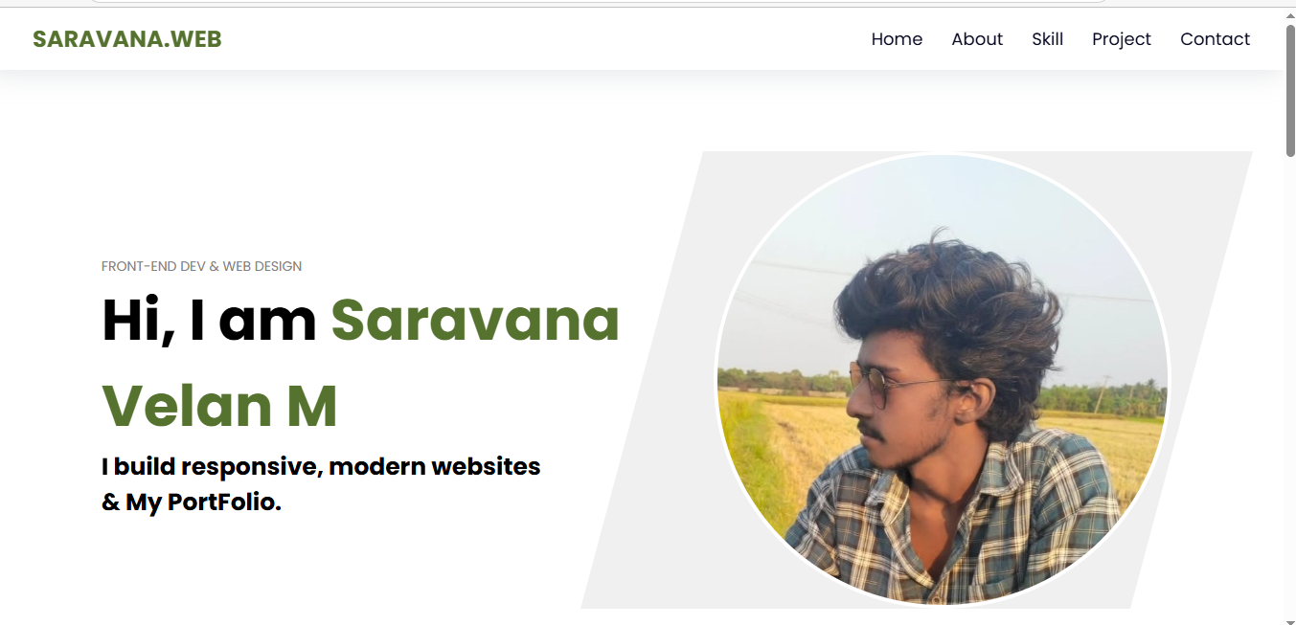
RESULTS AND SCREENSHOTS
3/21/2024 Annual Review
10

Slide 11
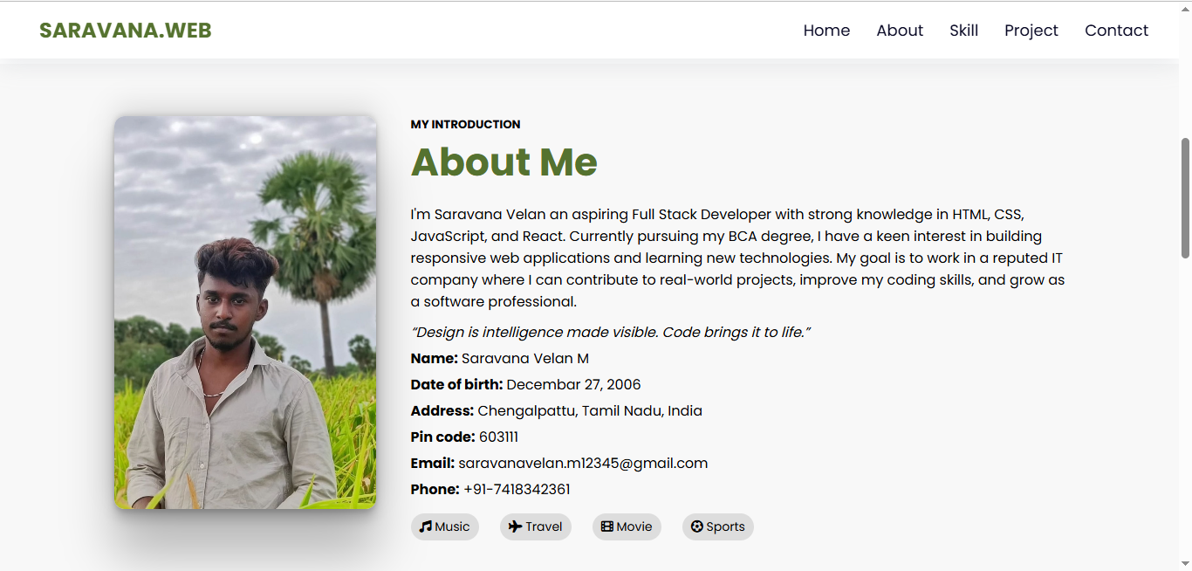
RESULTS AND SCREENSHOTS

Slide 12
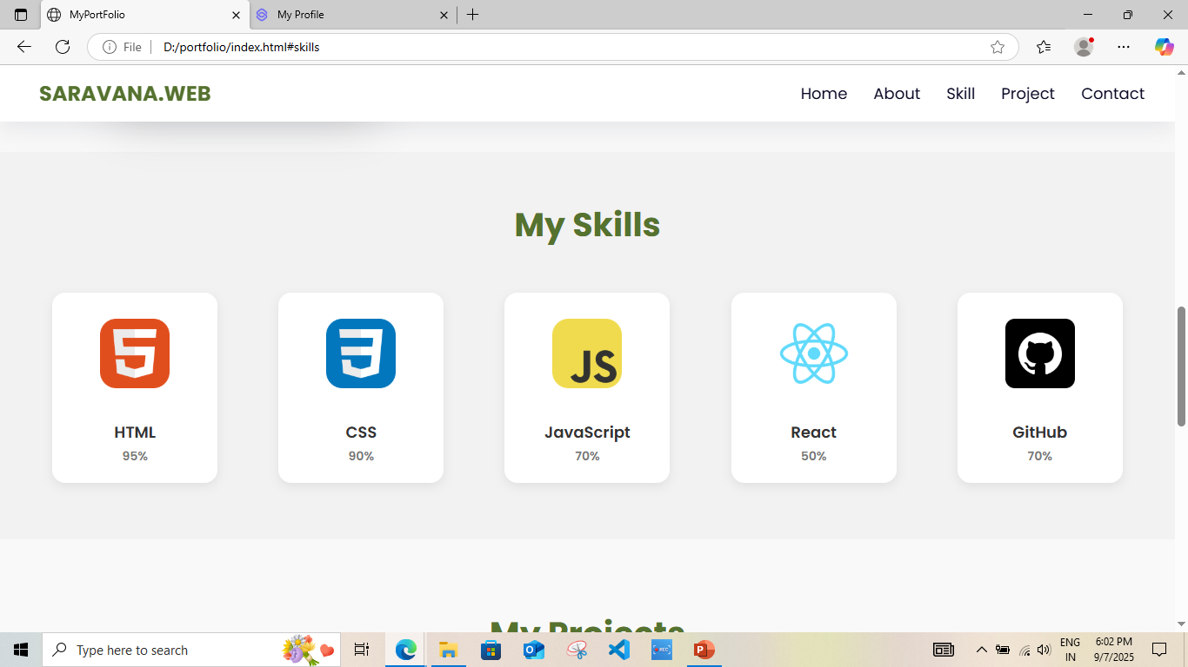
RESULTS AND SCREENSHOTS

Slide 13
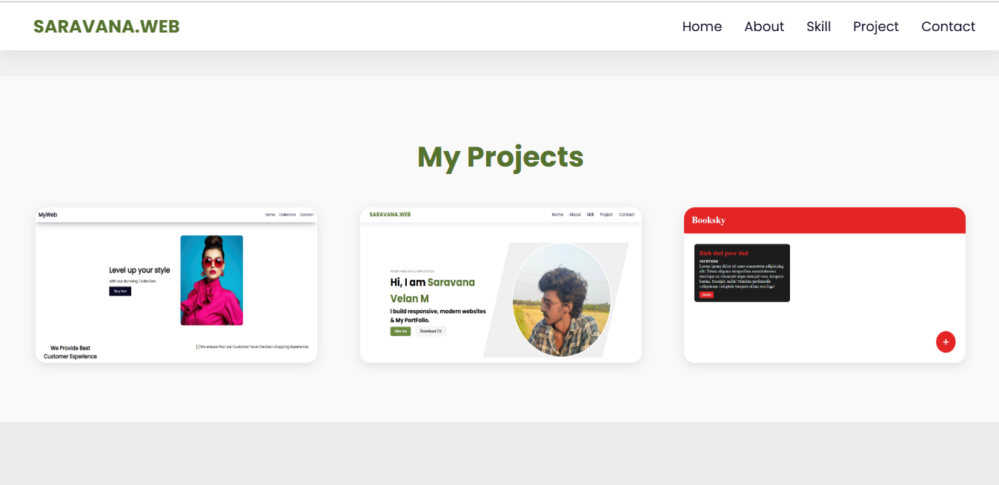
RESULTS AND SCREENSHOTS

Slide 14
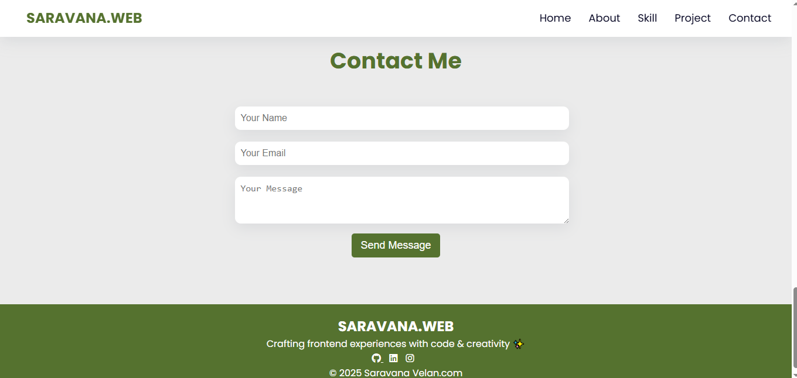
RESULTS AND SCREENSHOTS

Slide 15
CONCLUSION
❖THE PROJECT DEMONSTRATES HOW A CUSTOMIZED PORTFOLIO CAN BE USED AS A POWERFUL TOOL FOR PERSONAL BRANDING. IT HIGHLIGHTS MY ABILITY TO DESIGN,STRUCTURE,AND PRESENT INFORMATION IN AN INTERACTIVE FORMAT.
15

Slide 16
Github Link
https://saravana-velan-m.github.io/MyPrortfolio/

Slide 17
Thank you

